Slide 1
ML Agents: Unity & PyTorch
Using AI&ML in a Game Engine to create real time simulations for the built environment.
Marina Carretero. ADE Madrid

Slide 2
Background:
What is Unity:
The use of BIM, 3D modelling and innovative simulation techniques in the built environment are providing the opportunity to focus designs on the user and user experience.
The computational requirements to perform these simulations and models are often too much to perform with traditional methods and these are often very complex for both, the designer and the client/stakeholders.
On the other hand, the improvements on technologies used in the gaming industry are leading the real-time 3D computation and visualisation, which is promoting its use within the AEC industry.
Together with the real-time capabilities, the addition of AI and ML techniques to the object-oriented 3D environments could bring great opportunities!
The objective of my personal project for the AI/ML Masters module is to research on the AI and ML techniques available to use within the Unity Game Engine using a Python API, and to create a simple Agent Based Simulation (pathfinder) to explore future opportunities with this technologies.
Unity is a Game Engine traditionally used in the Game industry for video-game development.
The Lately, it is being used in the film and automotive industries and it is (slowly) being used in the AEC Industry.
In Arup there is a community of Unity users that is expanding every day, of which I am an active member. I use it for the development of digital deliverables, immersive environments and real-time simulations. We have recently been awarded as the Best Digital Project of the Year, with B.UX – Immersive Visualisation Roadmap.
The use of ML inside Unity is an opportunity to continue and improve the research done so far.
Unity could be used for the development of products related with asset management & digital twins, autonomous vehicles training, VR&AR for the construction industry…
The recent release of a PyTorch ML Toolkit for Unity can potentially help us in the development of new products and services.

Slide 3
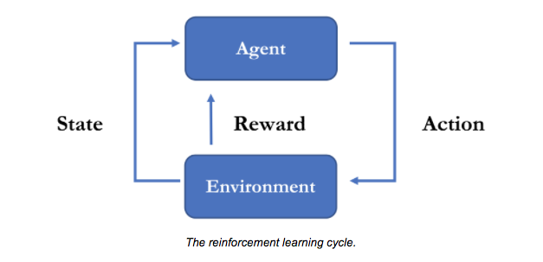
ML Agents Toolkit:
ML Agents is the toolkit provided by Unity to facilitate the communication between our immersive environment and the training/inference of the agents through the Python API and Tensorboard.
Many of the algorithms provided in the toolkit are based on Deep and Reinforcement Learning.
Most of the implementations are built on top of PyTorch. For the purposes of this project I will use ready-made Reinforcement Learning algorithms to train the agents.
As for the Supervised and Unsupervised Learning, Reinforcement Learning involves the same two tasks and the same two phases:
Tasks: attribute selection - define a set of observations, data obtained from the real-time environment, instead of from a given dataset as we saw in Module 1- and model selection -mapping from observations to actions-.
Phases: training phase -to learn the optimal policy through guided trials- inference phase -live in a new environment and perform the actions based on the learnt policy-
The main difference between supervised unsupervised and reinforcement learning is the type of data available to learn from.
Unsupervised Learning dataset = collection of attributes
Supervised Learning dataset = attribute-label pairs
Reinforcement Learning dataset = observation-action-reward.

Slide 4
The problem:
In order to understand and test the ML Agents toolkit, its capabilities and potential applications in the build environment I have chosen a simple problem to solve with Reinforcement Learning with Unity and PyTorch.
The problem to solve is to get the Agent to find the quickest escape route to the exit of a maze.
In order to solve this problem I have gone through different steps to understand the reward policy logic and process of ML Agents and reinforcement learning in general.
These steps have been:
Understand the tools and logic: to learn the basics I used the Hummingbirds step by step tutorial to get to train an agent (hummingbird) to eat the nectar of the nearest flower of the environment. This is a game itself but I found the logic could be applied to help solve my problem. All my work is saved in GitHub here.
Simplified version of the maze: train an agent to go from A to B as quick and straight as possible. Simple environment –agent, ground and target, no obstacles.
The real maze, with walls and multiple targets, where the agent needs to decide which ones to pass throught to get to the final target as quick as possible.
The basics.
Environment: is the scene where everything happens. It is our “digital world” where the agent will learn from and collect the data (observations).
Agent: autonomous actor that observes and interacts with the environment. In the context of Unity, an environment is a scene containing one or more Agent objects, and, of course, the other entities that an agent interacts with.
Observations: is a vector of floating point numbers which contain relevant information for the agent to make decisions.
Actions: are the instructions given to the Agent based on the observations. These actions can be continuous or discrete.
Rewards: for specific actions in order to reinforce the training.

Slide 5
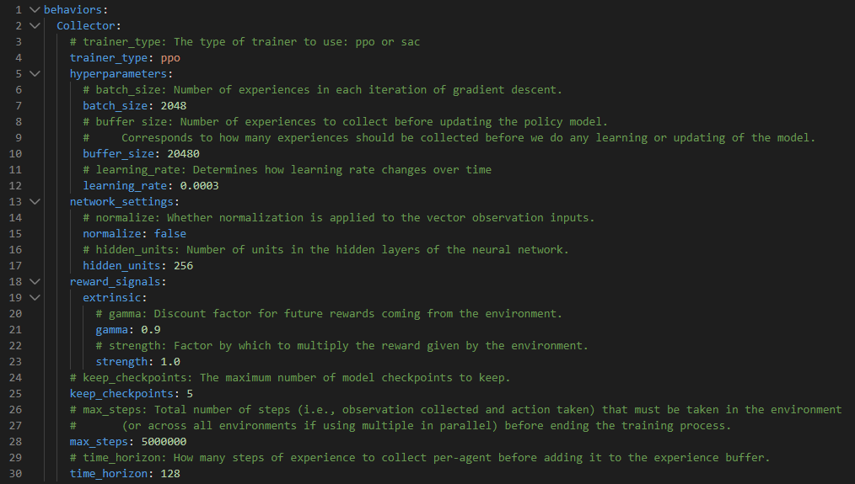
Training Set-up
The most common algorithms used within the ML Agents toolkit are PPO and SAC.
Our model (for both, the simple A to B model and the maze) will be trained using the Proximal Policy Optimization (PPO) algorithm of Reinforcement Learning. It collects a batch of experiences from the environment and updates the decision making policy. In other words, it collects the dataset from the interactions with the environment and changes the way of interacting with it on the next iteration. The algorithm is created so that the policy updates are not too drastic, so it goes slowly updating and improving the actions, without suddenly take a senseless action.
In order to run the training, we need all of the settings mentioned above (environment, agent, actions and rewards) and the training configuration file. The different settings available can be found in here. The configuration file I used in this project is shown on the image on the right.
Training configuration file for the project PPO trainer.

Slide 6
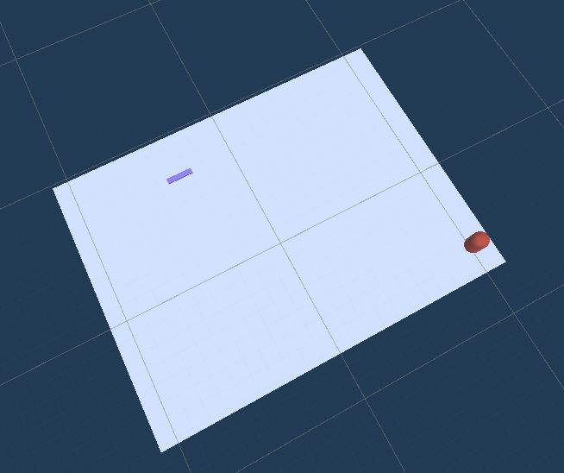
Simplified problem: A to B. Scene Set-up
Environment: for the simplified version of the problem, our environment will only consist of a ground plane, a target object and the agent.
Agent: a capsule collider.
Observations: they are specified in the “CollectObservations” method that is later attached to the agent. This will be the data to take actions from. In this case we want to observe the current position of the Agent, the target position and the velocity of the agent.
Actions: in this case the actions of the Agent will be to move on the x and y axis. These are specified in the “OnActionreceived” method.
Rewards: we need ot reward the agent for it to improve its performance and take the “correct” actions. We don’t only want it to move randomly across the ground plane, we need it to move towards the target and don’t fall off the ground. Therefore we will reward positively theAgent-target collision and negatively the fall off the platform (agent position.z < 0).
Note: Observations, actions and rewards are specified on a C# script attached to the agent. It can be found in my GitHub here.
Target
Agent
Ground
Environment (training ground) for the A to B model

Slide 7
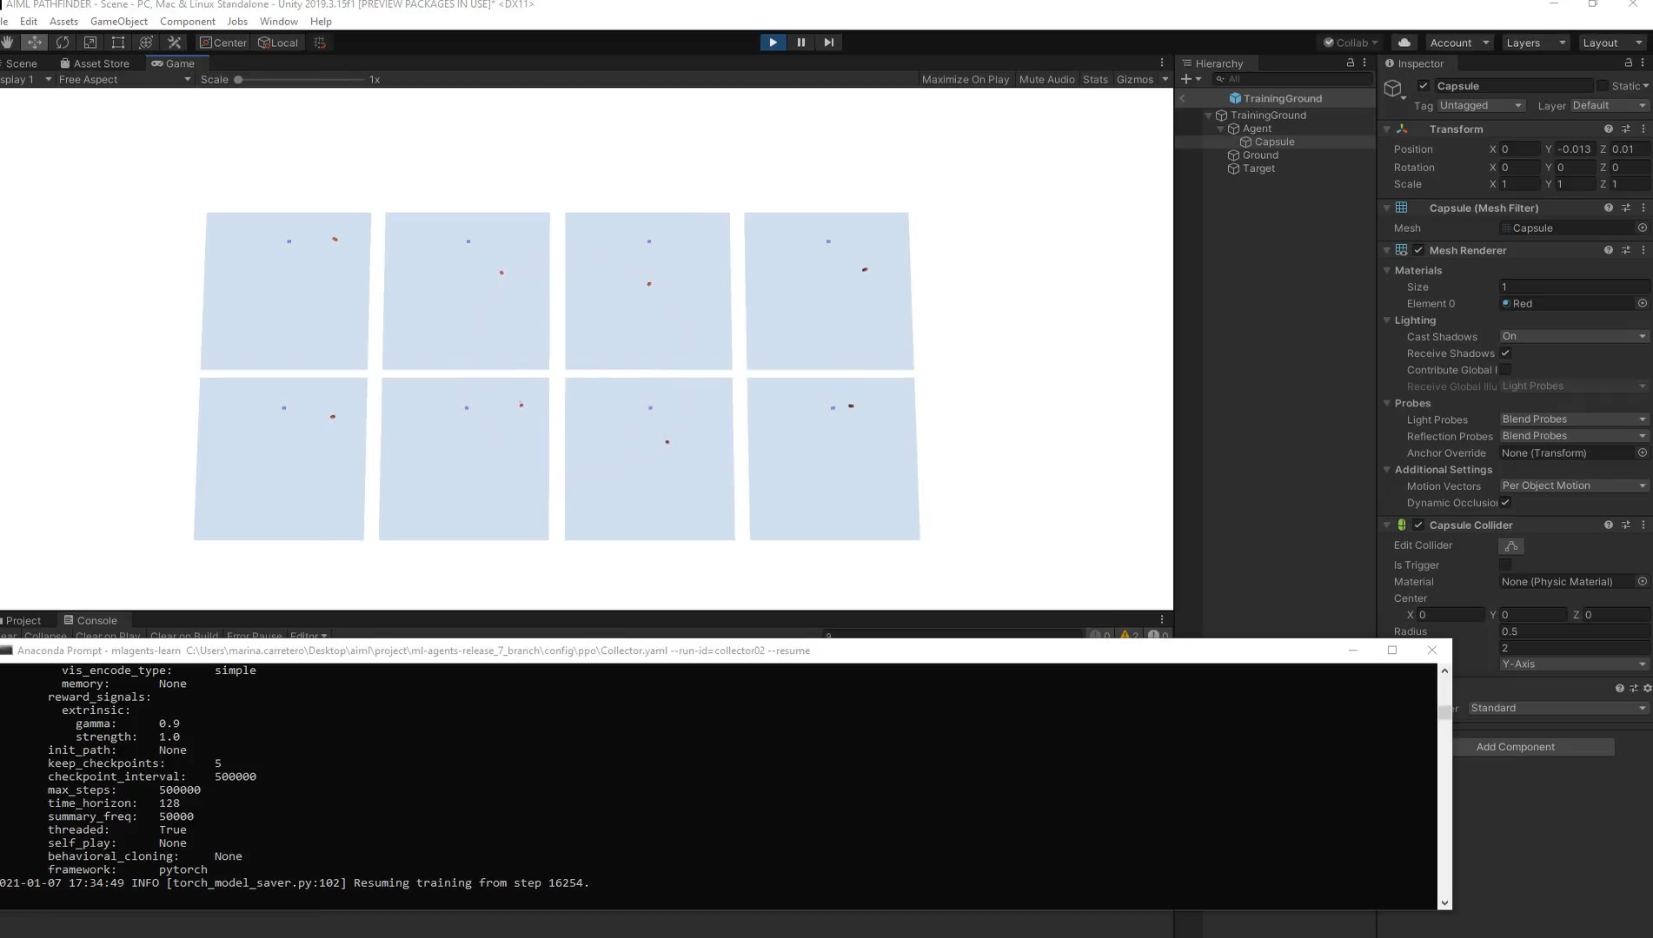
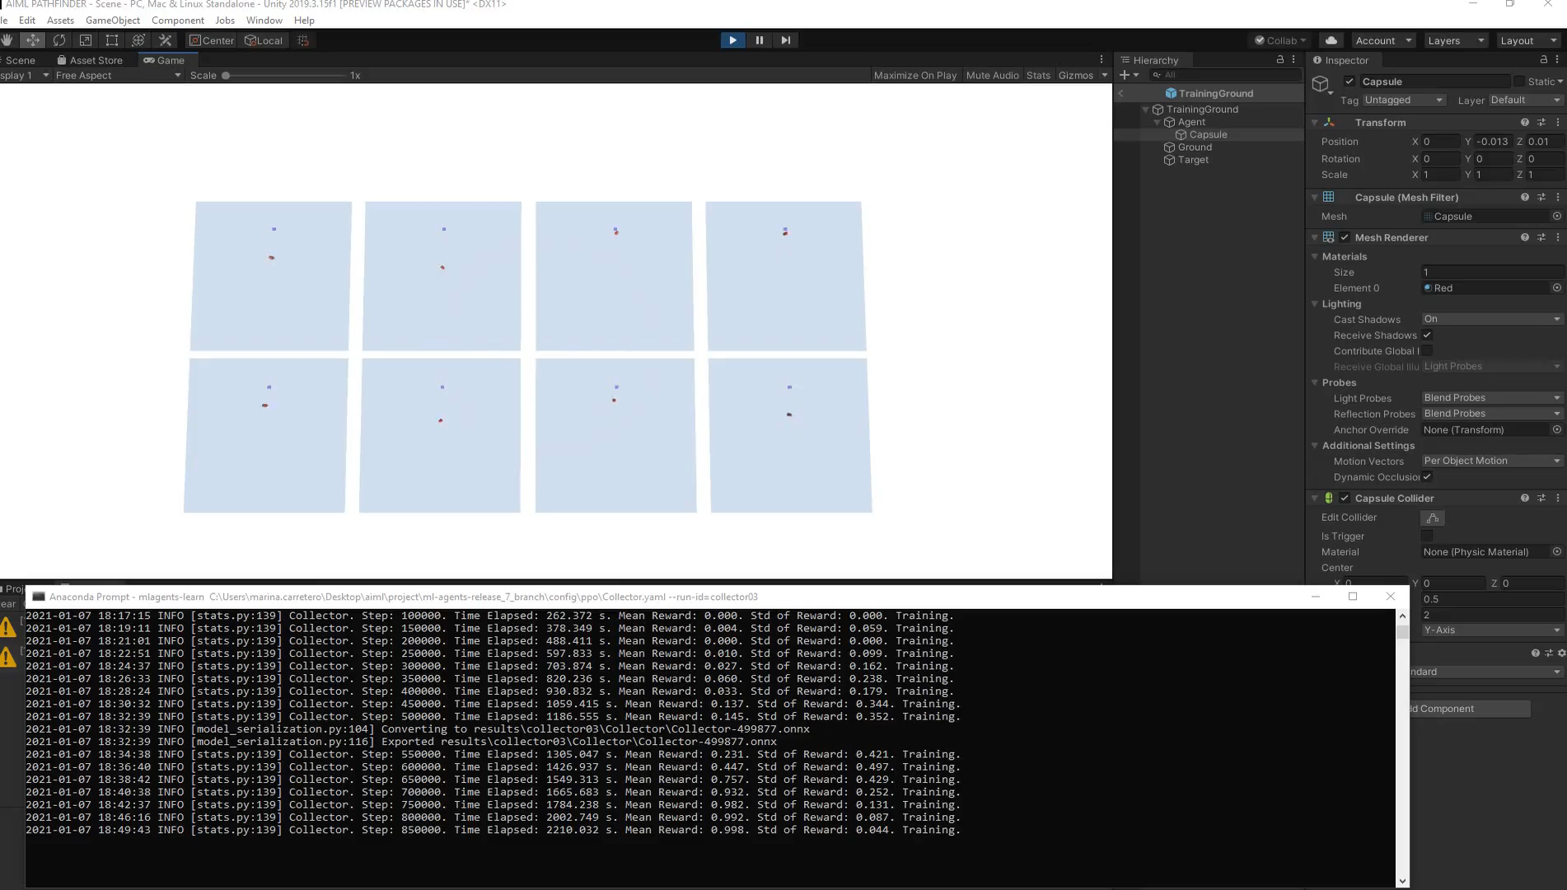
Simplified problem: A to B. Training evolution
Video 1: Training ongoing at step 16254 (beginning of the training).
Video 2: Training ongoing at step 800000 (Agent plateaud, commulative reward stacked).

Slide 8
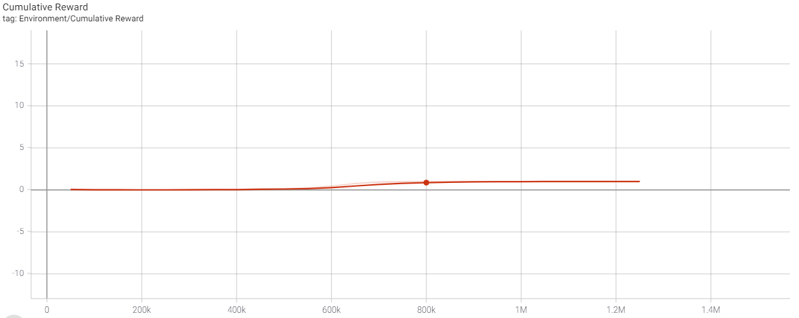
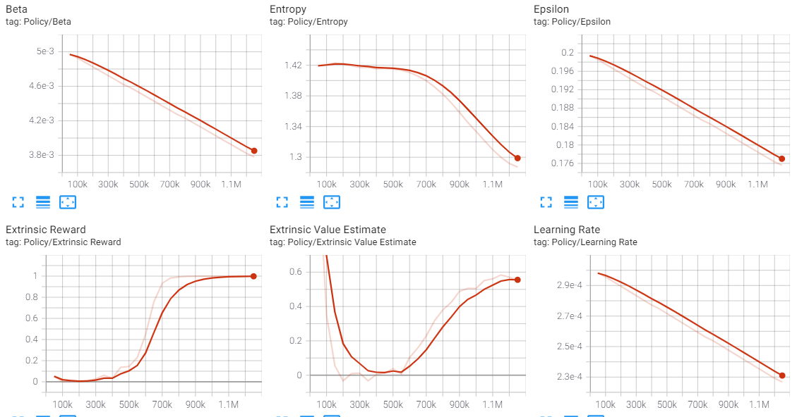
Simplified problem: A to B. Conclusions
The agent took 30min to get to the 800k steps, were it plateaud, stacking the cumulative reward close to 1.
After this point, the training was stopped and a .onnx file was saved. This file could then be used for inference in different environments and simulations.
The logic needed to set-up the agent, actions and rewards was simple enough to focus on other aspects of the process needed to implement ML Agents, such as the scene set up, configuration files, Python API and TensorBoard.
The development of this model served as the starting point for the development of the Maze, the next challenge.
Target
Agent
Ground
TensorBoard graphs for the cumulative reward and policy values of the training process.

Slide 9
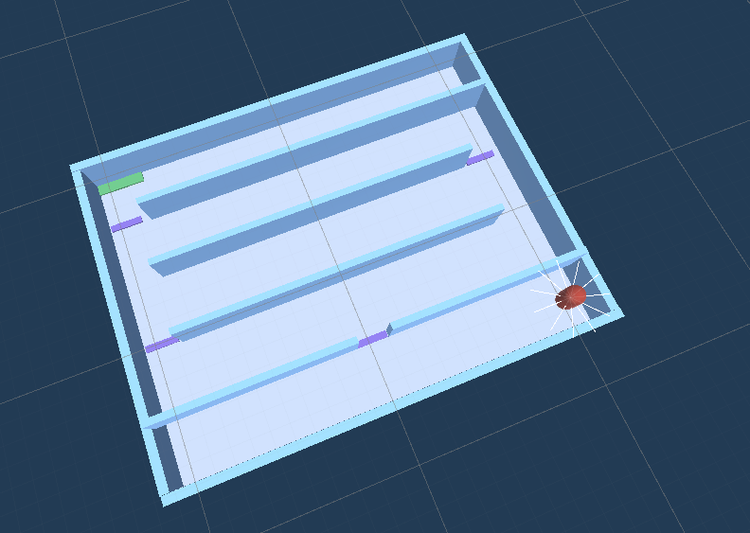
The problem: EscapeRouteFinder Scene Set-up
Environment: the environment of the Maze consist on the same Agent, ground and final target as the previous version. We are now adding the walls, “on path targets” and rays.
Agent: a capsule collider.
Observations: they are specified in the “CollectObservations” method that is later attached to the agent. This will be the data to take actions from. In this case we want to observe the current position of the Agent, the nearestTarget position, the velocity of the agent, the relative distance to target and the Agent rays hit (raycast observations).
Actions: in this case the actions of the Agent will be to move on the x and y axis. These are specified in the “OnActionreceived” method.
Rewards: in this case we need to reward the agent positively each time it collides with one of the targets and negatively each time it collides with the outer walls.
Note: Observations, actions and rewards are specified on a C# script attached to the agent. It can be found in my GitHub here.
Final Target
On Path Targets
Agent
Raycast observations
Ground
Environment (training ground) for the Maze Pathfinder model

Slide 10
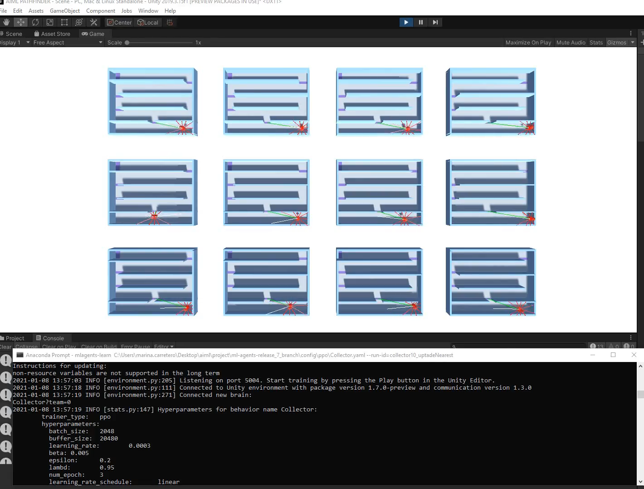
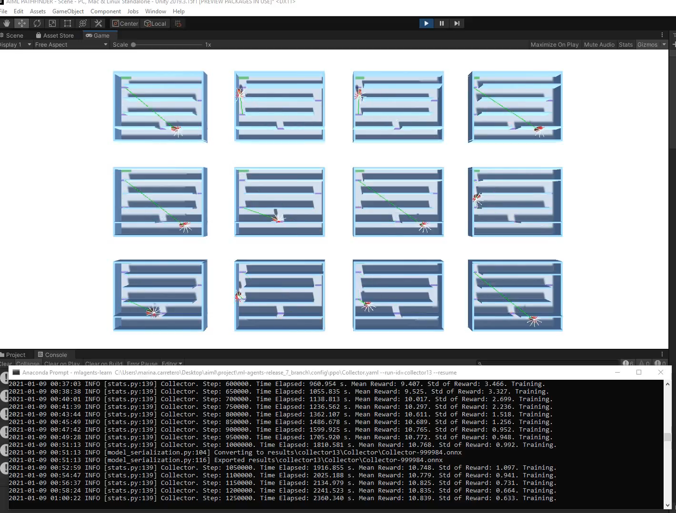
The problem: EscapeRouteFinder Training evolution
Video 3: training start point
Video 4: Training finishing (Agent plateaud, commulative reward stacked).

Slide 11
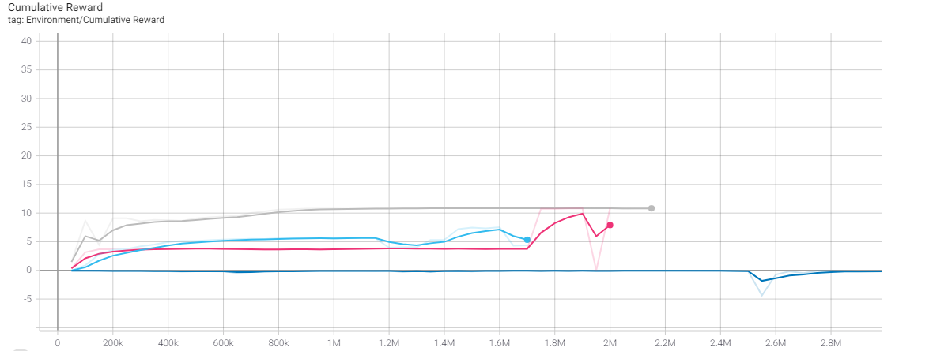
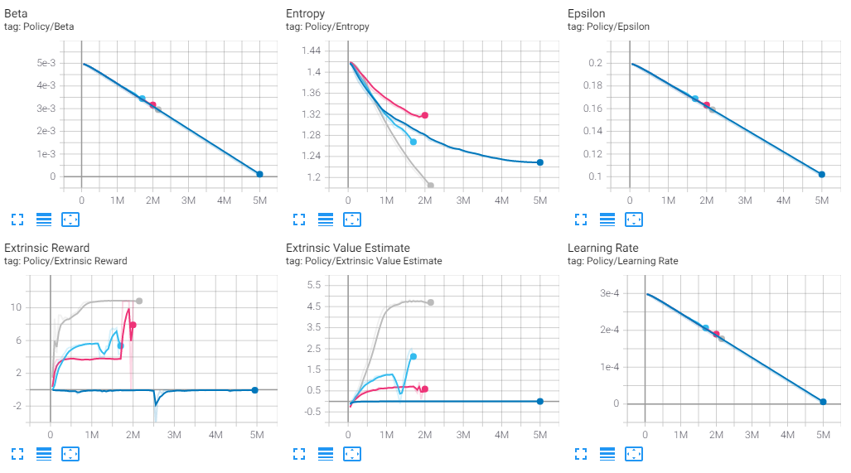
The problem: EscapeRouteFinder Conclusions
Target
Even though this is still a relative simple problem, it took me some time to build up the logic of the model (actions and rewards), although after these tests it is now clear, that with a technical lead, anything is possible!
As the dataset is being created realtime in the environment that we are creating, it is very important that the “instructions” are accurate and mathematically correct, so that the output data for policy making is not biased.
It has been a challenge to get the Agent learning to reach the final target. Each line of code and each decision will drastically affect the training of the agent.
It is also worth noting the importance of a good balance between positive and negative rewards so that the Agent doesn’t frustrate and get stacked in the process.
Recordings for most of the training trials (for the hummingbirsd, AtoB and EscapeRouteFinder) can be found in here.
Agent
Ground
TensorBoard graphs for the cumulative reward and policy values of the training process (each color represents a different version).

Slide 12
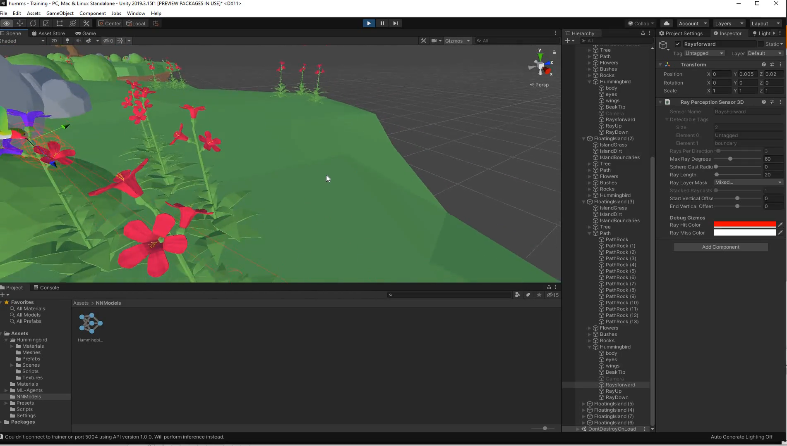
Conclusions:
In module 1 we had theoretical and practical insights of supervised and unsupervised ML.
Given my current position and experience with Unity, I took the opportunity to research further about the new ML Agents Toolkit and explore the what it could bring to the AEC industry.
The models shown in this report are only simple examples of what could be done, not only for simulation modelling but also for real life machine training (for example, to train a drone to perform remote inspections, train autonomous vehicles etc).
As for any other ML technique, it is worth remembering that the quality of the training and learning will only be as good as the data collected (or in this case the policy/actions logic).
This has been made obvious in my experience when comparing the logic used by a professional Unity ML Developer (as seen in the hummingbirds project) vs the logic implemented by a not-so-technical profile (my own EscapeRouteFinder).
There is still a lot to learn and new technologies and algorithms are developed by the second. I will continue with this research in the coming months as a continuation of our award-winning B.UX Immersive environments roadmap.
Video 5: Inference after one training for the Hummingbird project.

